Slide 2
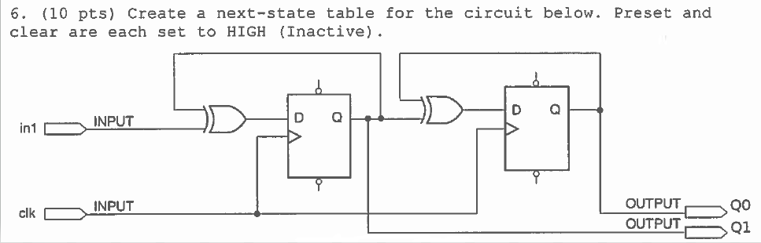
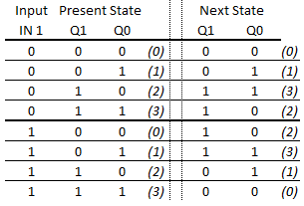
(“Next State” is what’s on “D” now)

Slide 3
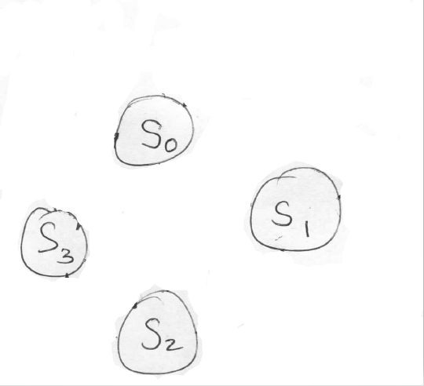

Slide 4
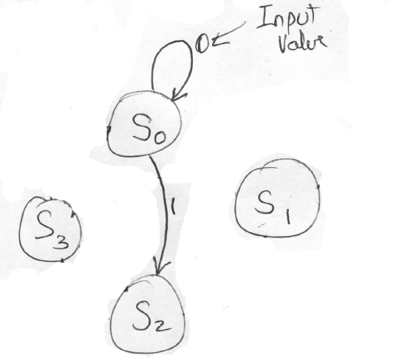

Slide 5
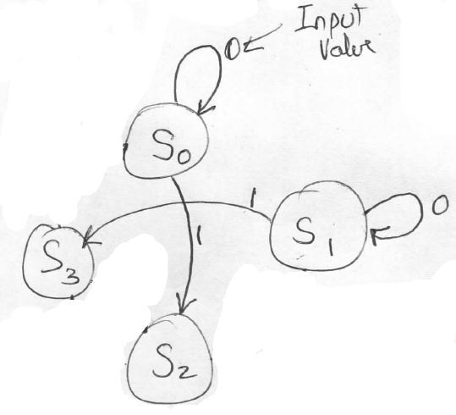

Slide 6
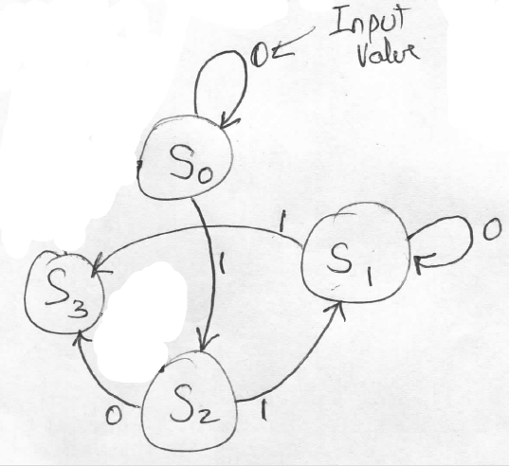

Slide 7
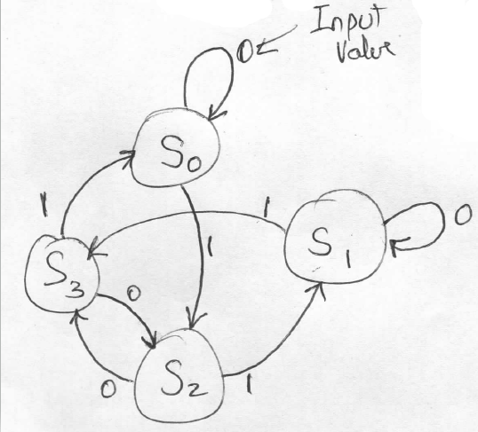

Slide 8

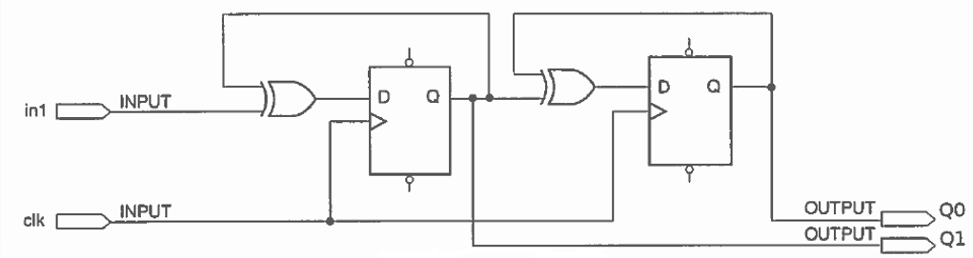
(Remember: “Next State” is what’s on “D” now)
So we make logic that will output D1 and D0
D1 = /In Q1 + In /Q1
D1 = In
Q1
Boolean equivalency rule:
D0 = /Q1 Q0 + Q1 /Q0
D0 = Q1
Q0

Slide 9
Stoplight

Slide 10
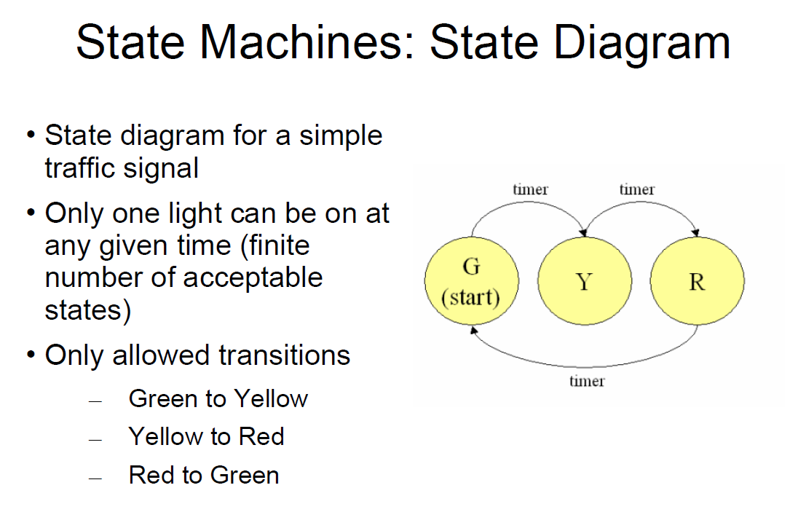

Slide 11
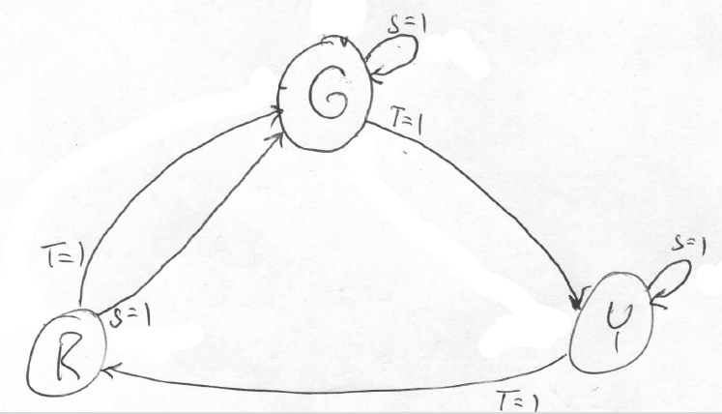

Slide 13
D1 = /S T Q0
D0 = /S T /Q1 /Q0 + S /Q1 Q0

Slide 14
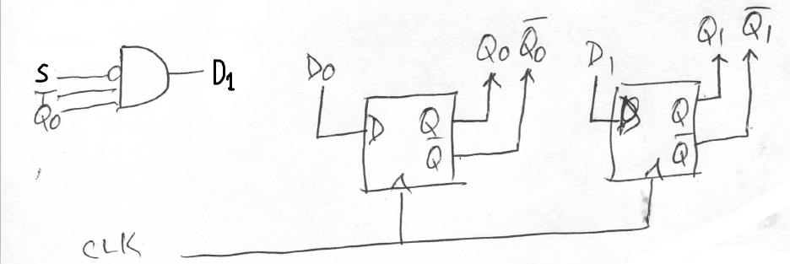
D1 = /S T Q0
D0 = /S T /Q1 /Q0 + S /Q1 Q0
S
T
Q1
Q0
D0

